Slide 1

Nyc Taxi data ANALYSIS PROJECT
Name : Latifah Alnaim
Data Science Bootcamp Saudi Digital Academy

Slide 2
Table of Content :
Introduction
Data
Analyzing Data
Modeling
Conclusion

Slide 3

- Introduction :
What is the importance of Data Science ?
The purpose of Data Science is to extract, pre-process and analyze data. Through this, companies can make better decisions. Various companies have their own requirements and use data accordingly. The goal of Data Science to make businesses grow better.

Slide 4
Data :
What is NYC Taxi ?
In New York City, NYC taxi is a biggest taxi company in United state, to transferring passengers to the desired location they want to go.
NYC taxi Data has too many null values and massive information , for that I chosen it to fix these small problems and make the prediction on.

Slide 5
Visualization
and
Data Analyzing :

Slide 6

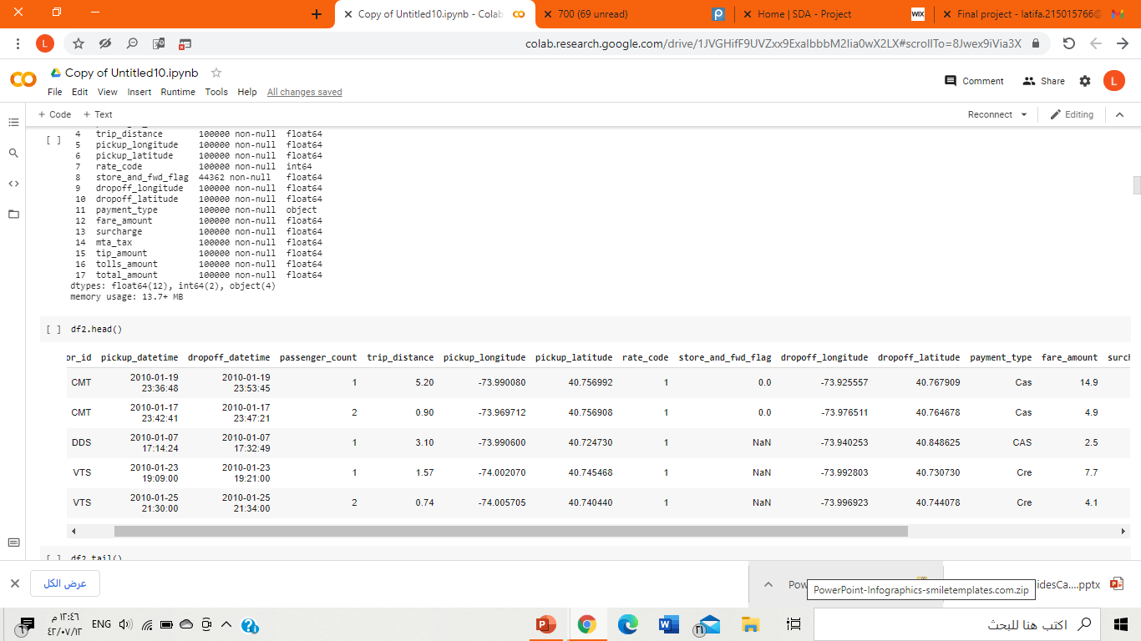
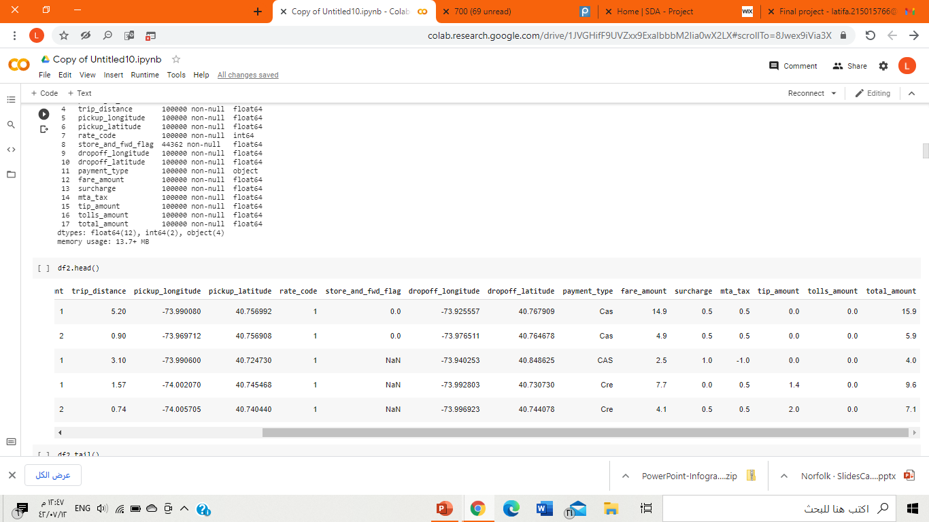

Slide 7
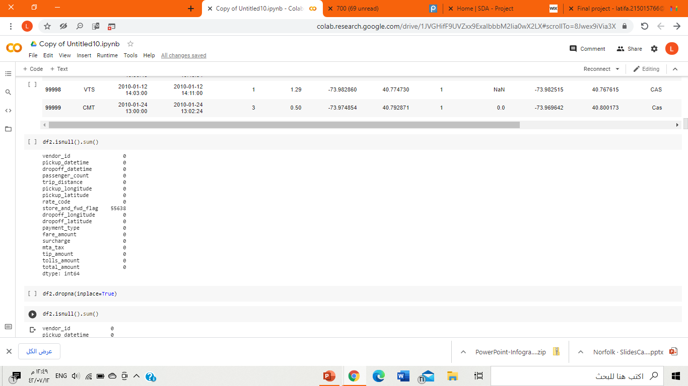

Remove null values :

Slide 8
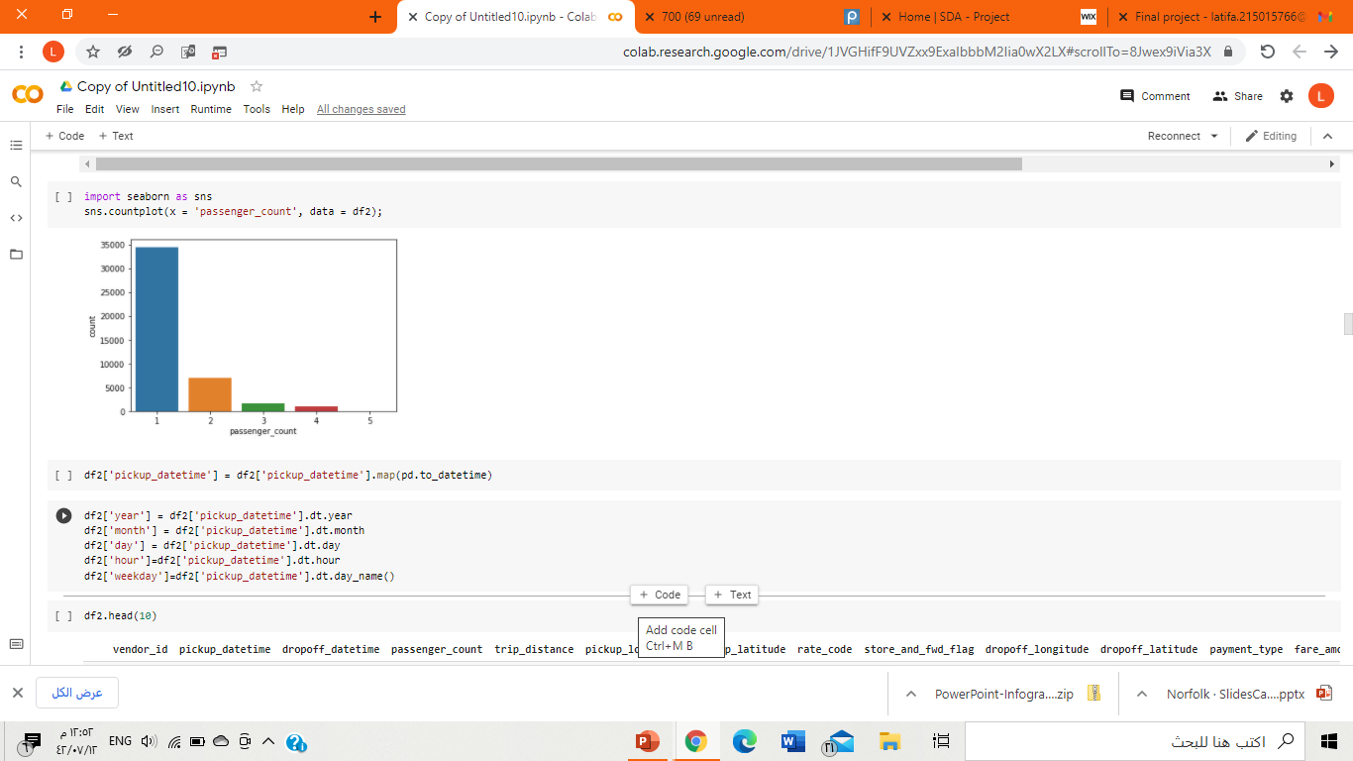

As we see in the left side the passenger count in NYC taxi , They include from 1 to 5 passengers in the trip. And as we see the one passenger has the higher chance to be in a trip. In my opinion, it is better to make promotional offers and special packages for passengers of more than 3, to motivate customers to use the NYC taxi.

Slide 9

Charts
As we can see in the pie chart the percentage of NYC taxi used on weekdays and weekends. It is quite natural that NYC taxi used on weekends exceeds normal days.

Slide 10
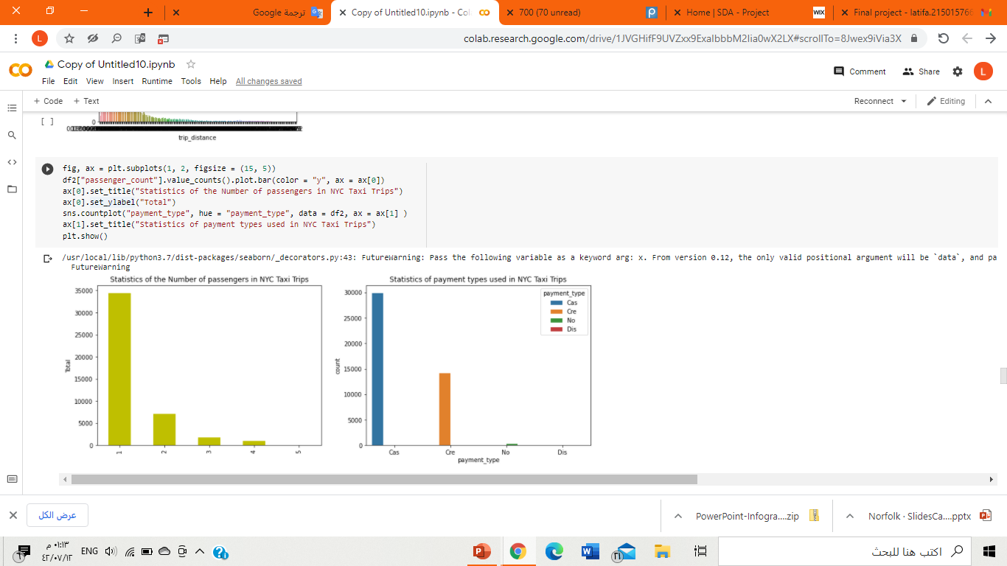
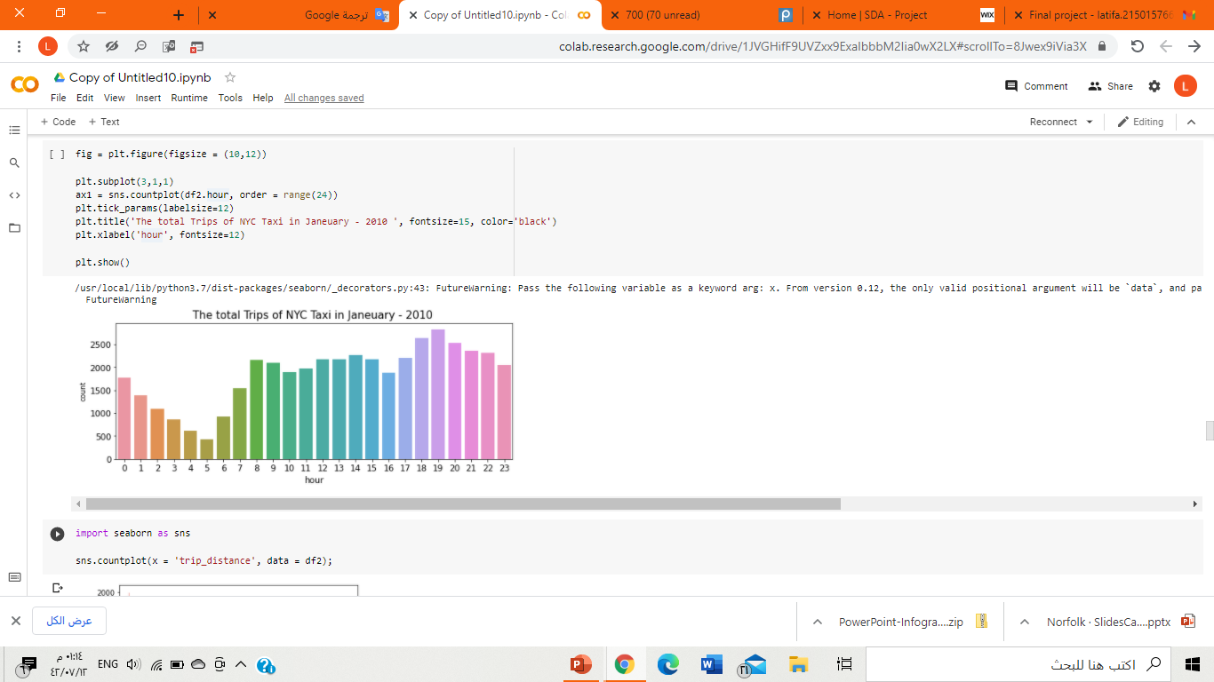
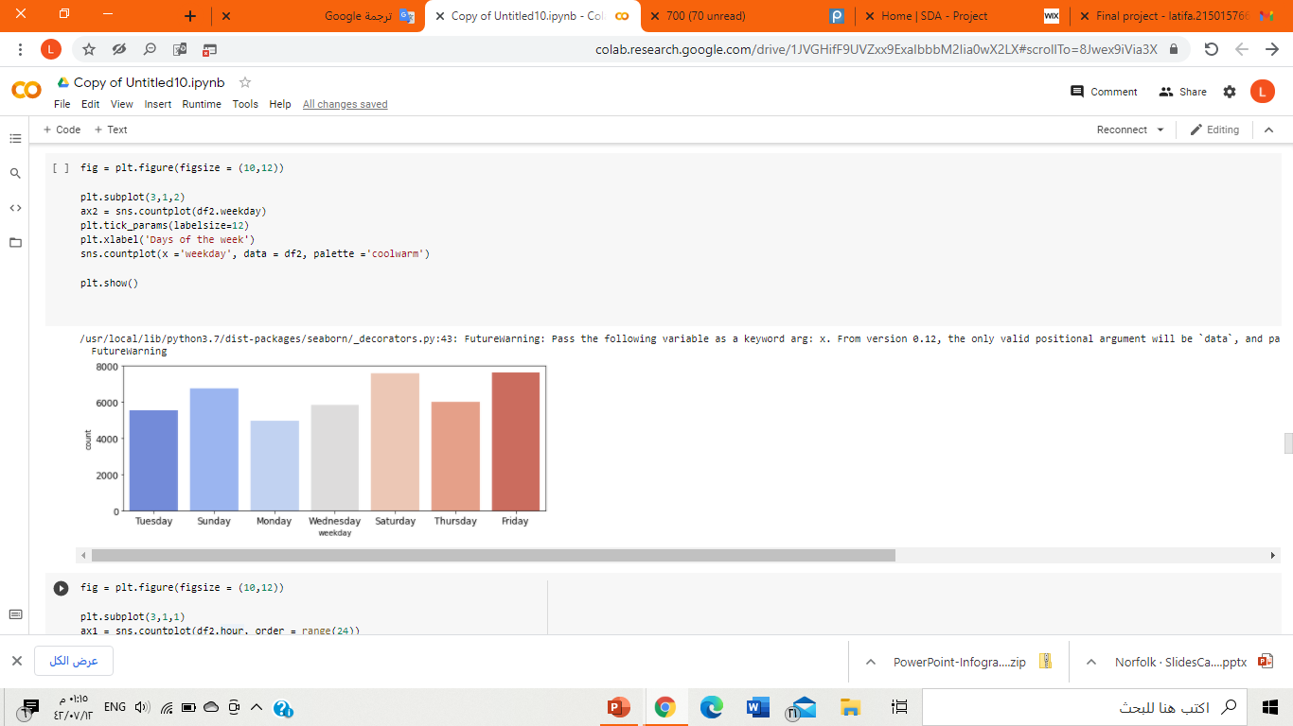

Slide 11
Modeling

Slide 12
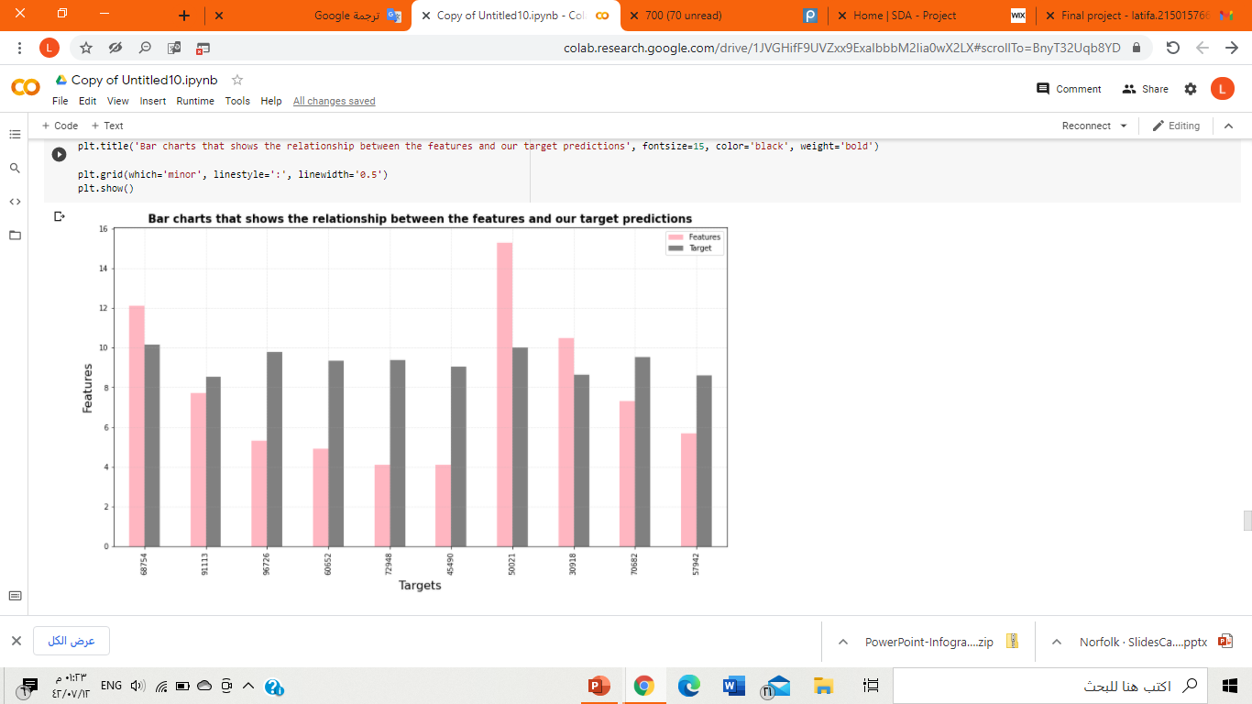
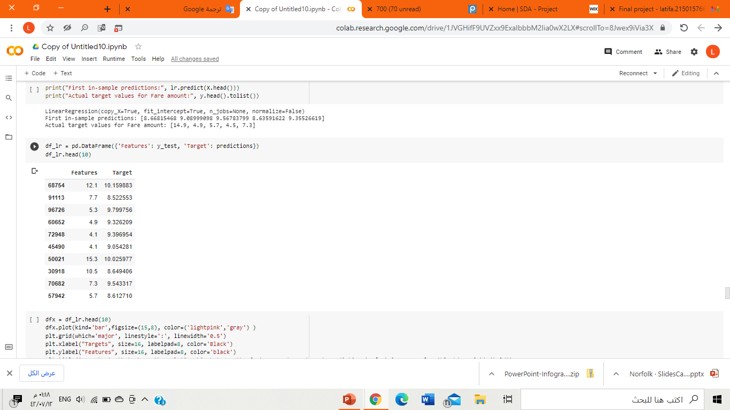
Linear Regression Model
The relationship between the independent and dependent variables is linear.

Slide 13
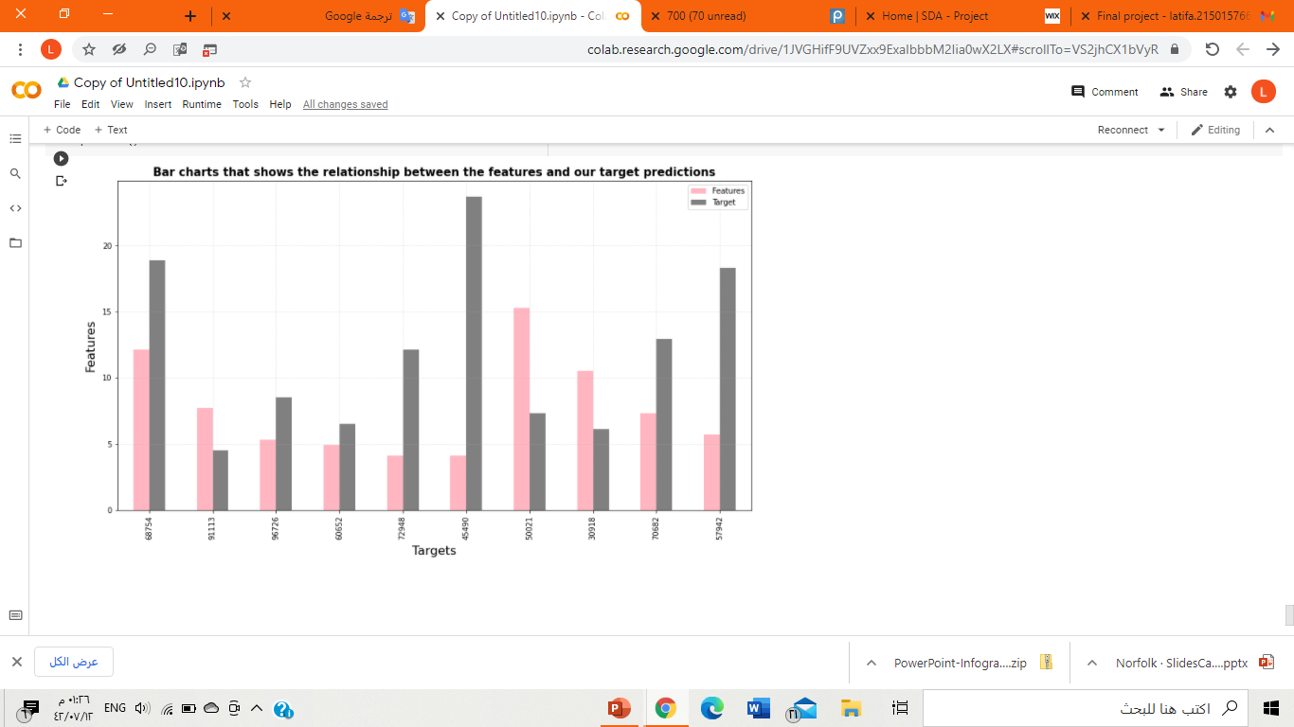
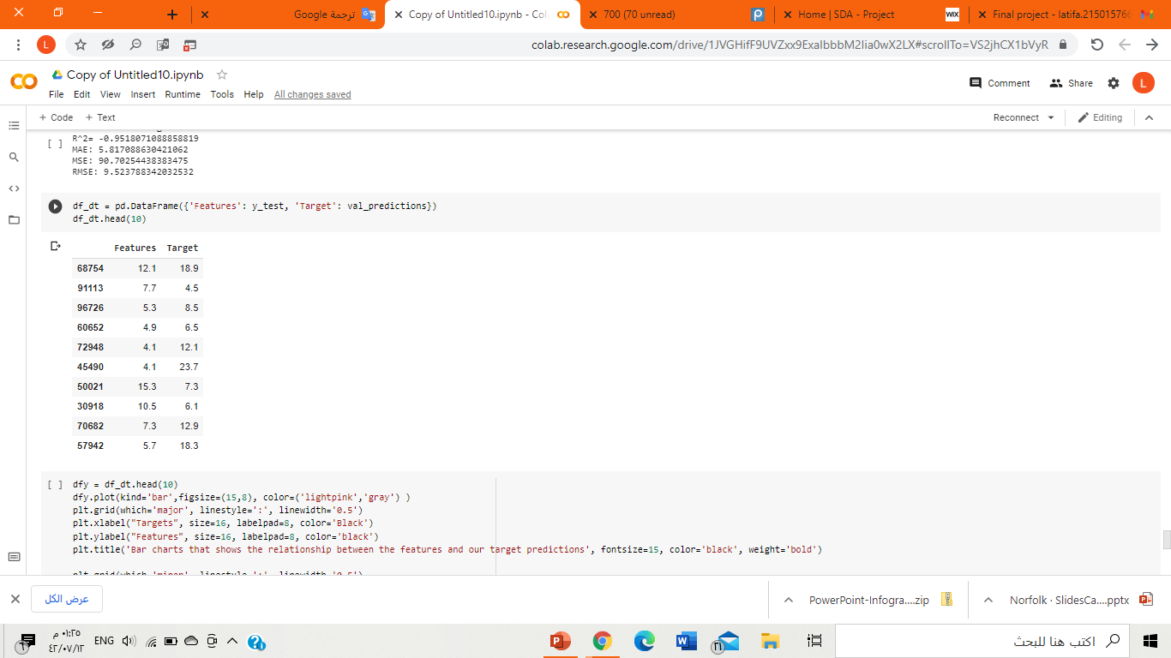
Decision Tree Model
There are number of non-linear regressors to choose from, but I will implement a Decision Tree Regressor first for couple of primary reasons:
it is the easiest to interpret
does not require feature scaling

Slide 14
Thank you all

